Slide 1

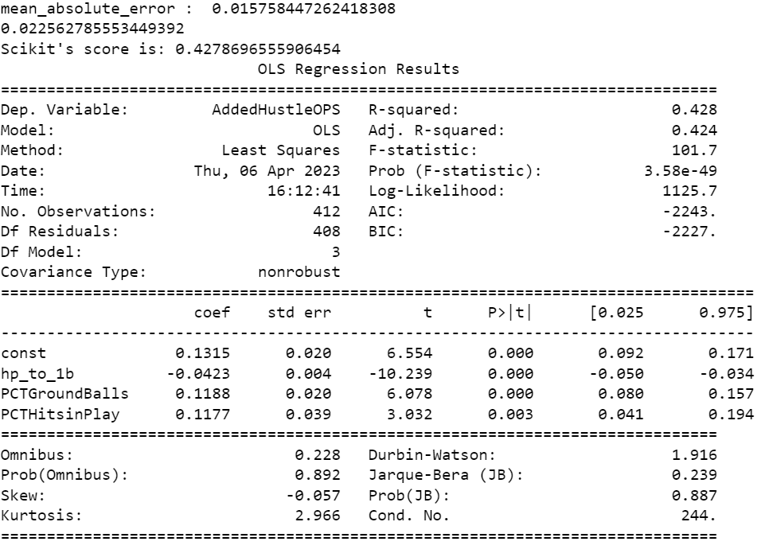
Using Linear Modeling and Clustering to Determine Relationships Between Speed to First Base and Other Offensive Statistics in Baseball
https://github.com/T4rnover/DataScienceProject_Spring
Eamon Deffner and Frederick R. “Randy” Carlson

Slide 2
Problem Statement and Goals
Motivation - Baseball is a game in which speed is no longer as sought after as an attribute because of other statistics. However, players who can beat out ground balls get on base more, leading to the driving question for this project.
Research questions
What is the contribution towards On Base Plus Slugging of speed from home to first in baseball?
Are there particular groups of players who have high contributions to their offensive statistics from plays that involve speed
Goals
Determine whether there is a relationship between speed and batting average on ground balls, as well as speed and slugging on hits that are not home runs
Cluster players based on how often they are involved in hustle plays, their successes in these plays and how this affects their OPS
Data: From BaseballSavant

Slide 3

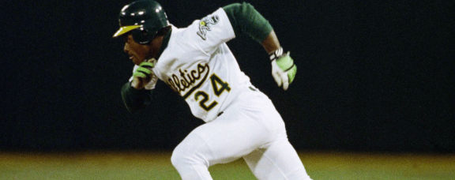
Previous Work
Moneyball (Lewis)
The Rickey Henderson Dilemma (Click, et. al.)
Vectors for Taking the Extra Base
Relationship between Speed and OBP/Slugging

Slide 4
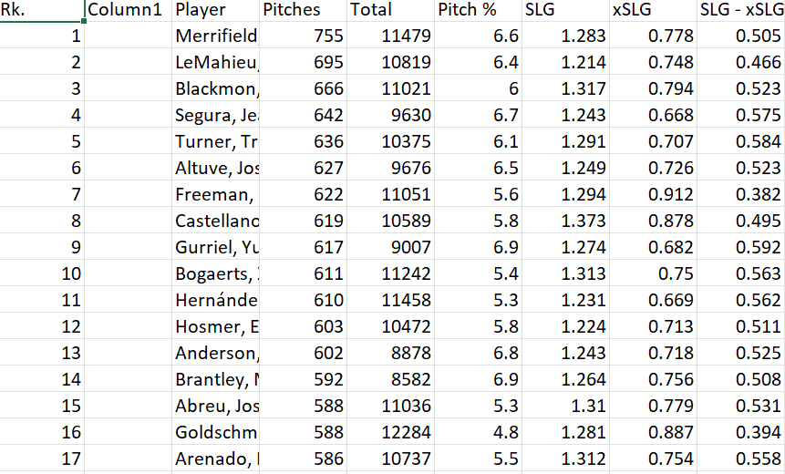
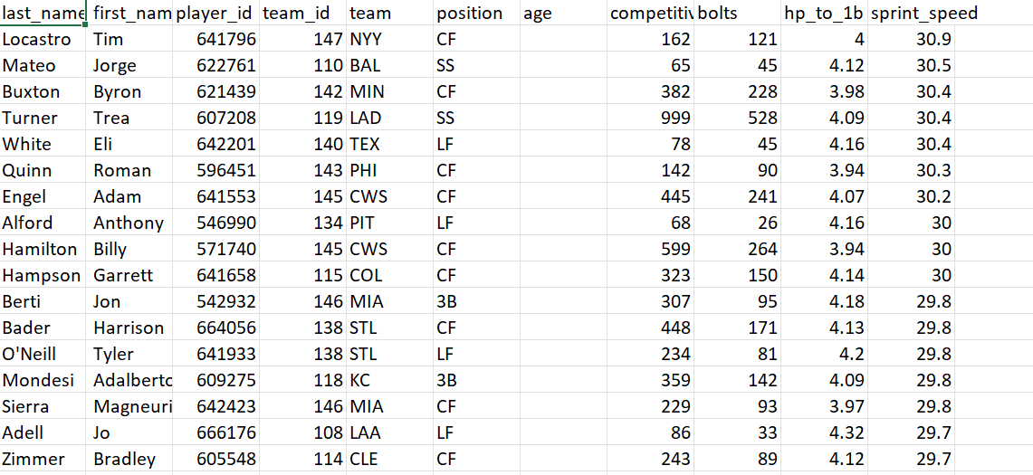
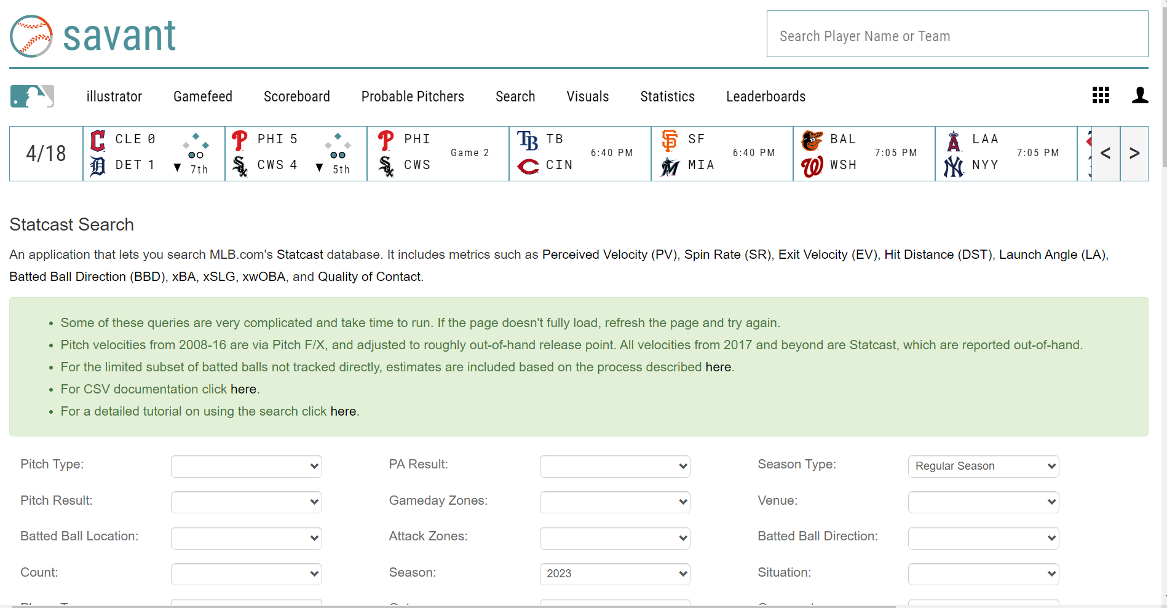
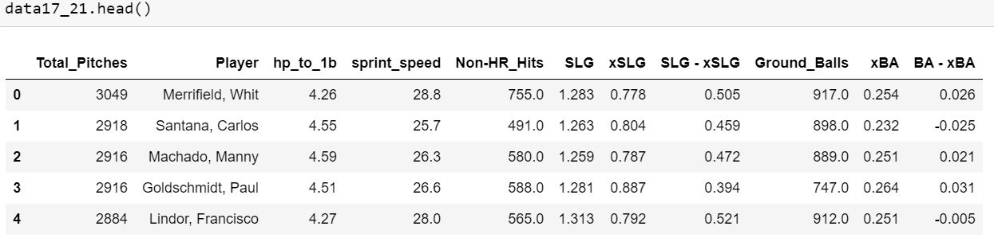
Data
Baseball Savant tracks stats on every pitch in all MLB games. Easy to find and use.
Combined Speed Data with Hitting Data for each Player

Slide 5
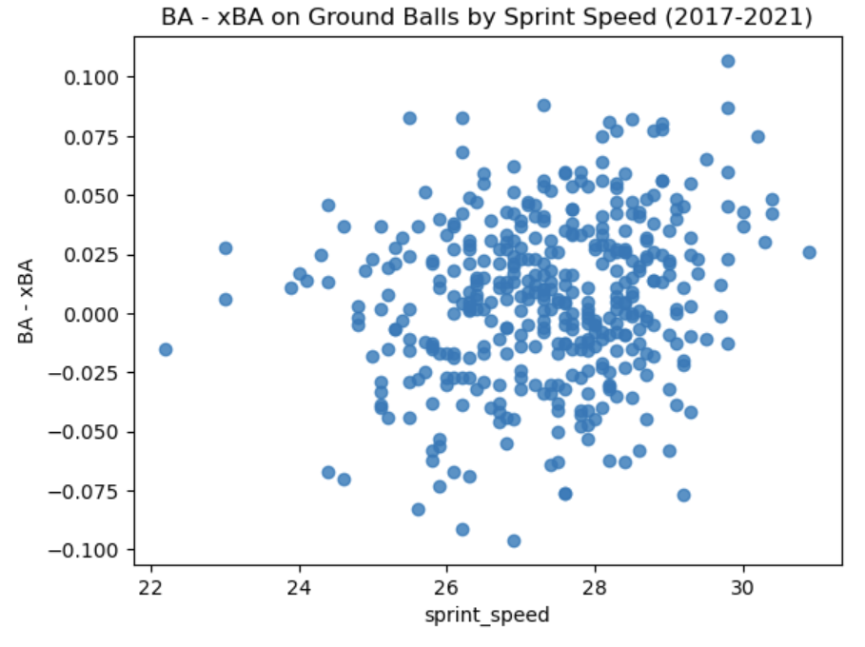
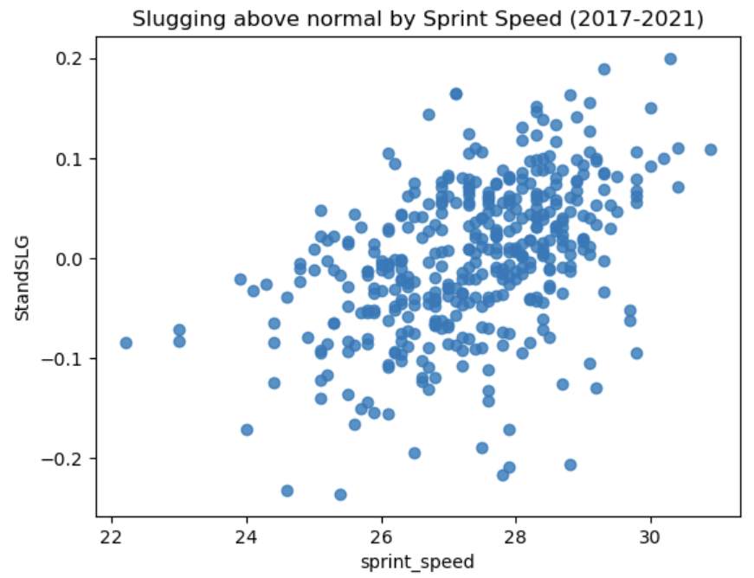
Exploratory Data Analysis- First Models
Standard Slugging and BA-xBA
Sprint speed vs. Home to first
Created graphs to see if there was a visible relationship
Originally, not much. But slugging appeared to have more of one
Definition of a hustle play

Slide 6
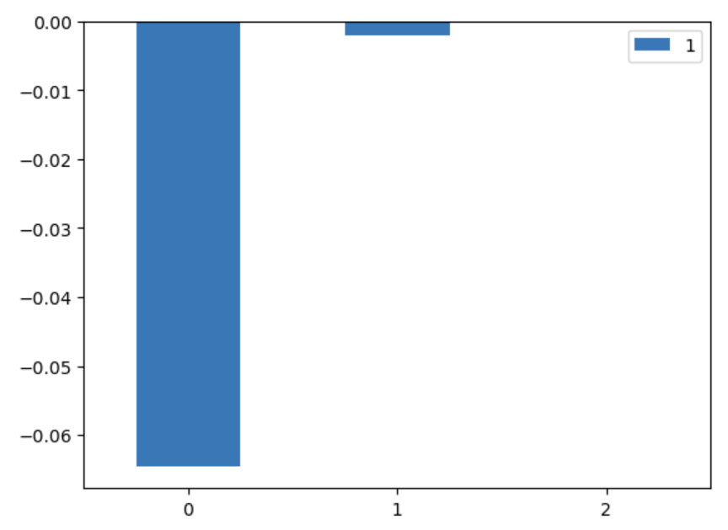
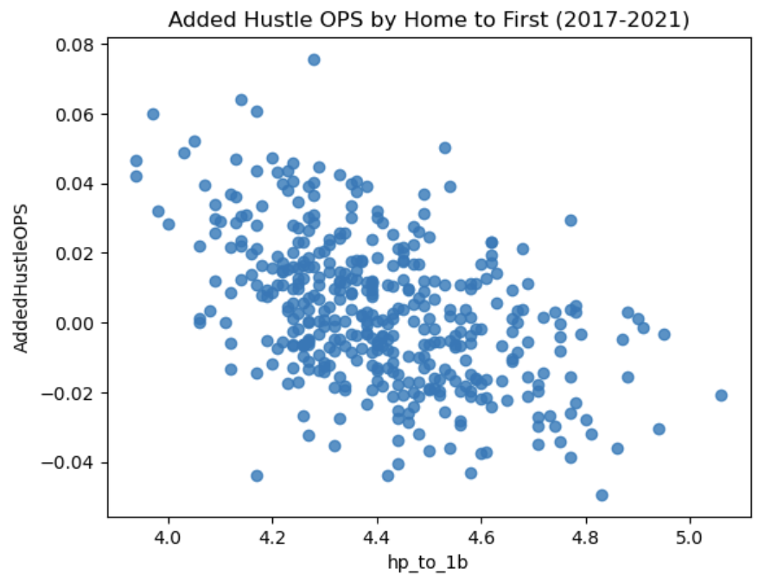
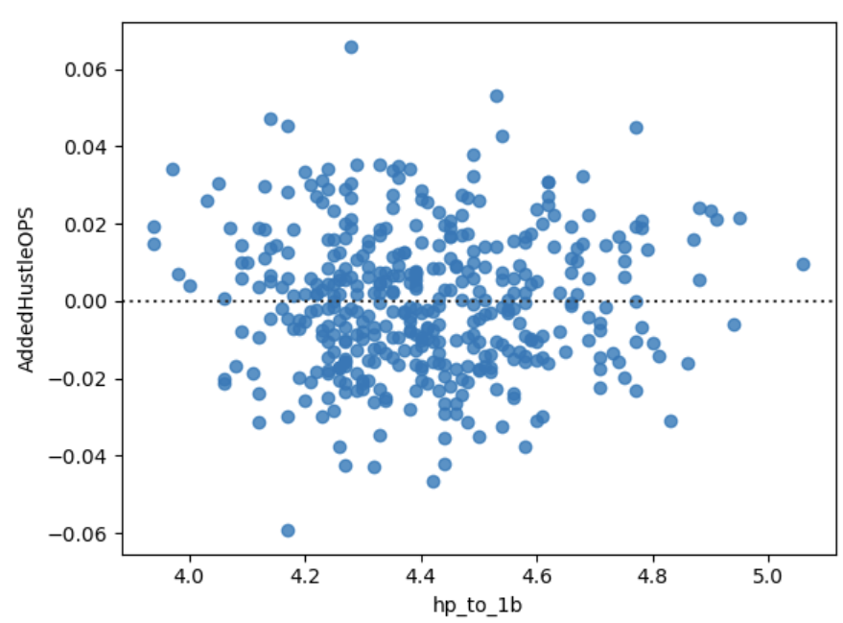
Exploratory Data Analysis- Models of Clustering on Number of Plays
Feature engineering to create AddedHustleOPS
Much more of a relationship here, using frequency of these plays and success rate
Not directly caused by speed, but faster players appear to have some OPS added based on speed.
Feature importances for predicting Added Hustle OPS based. Feature 0 (time from home to first) is the only one that was statistically and practically significant. Feature 1 (number of plate appearances) and Feature 2 (sprint speed) was not included in the final model.
Relationship between Added Hustle OPS and time from home to first base. There appears to be somewhat of a linear relationship here, but it is not very strong. Residuals are shown to the right, and appear random enough.

Slide 7
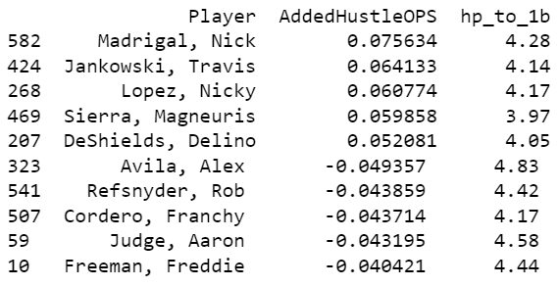
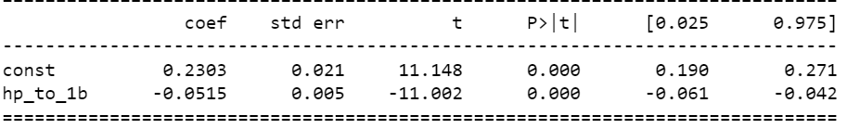
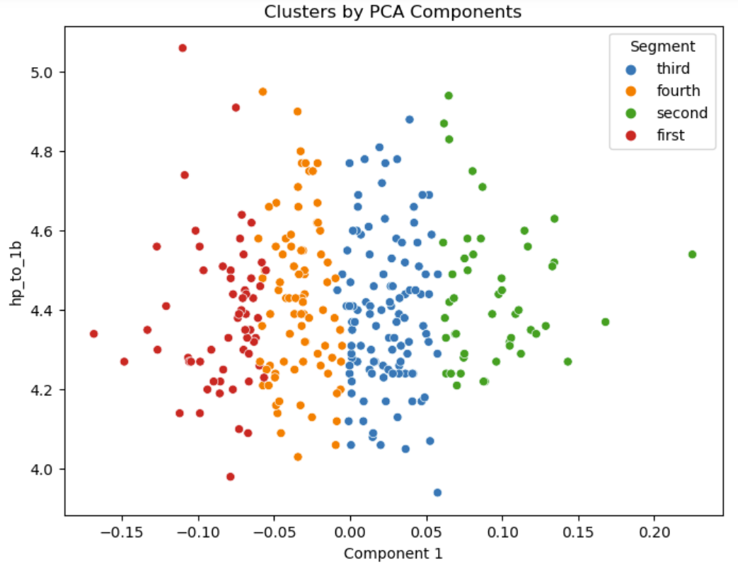
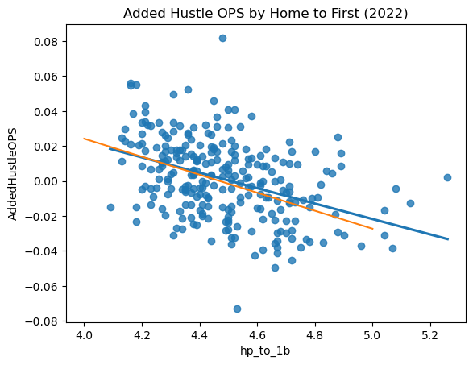
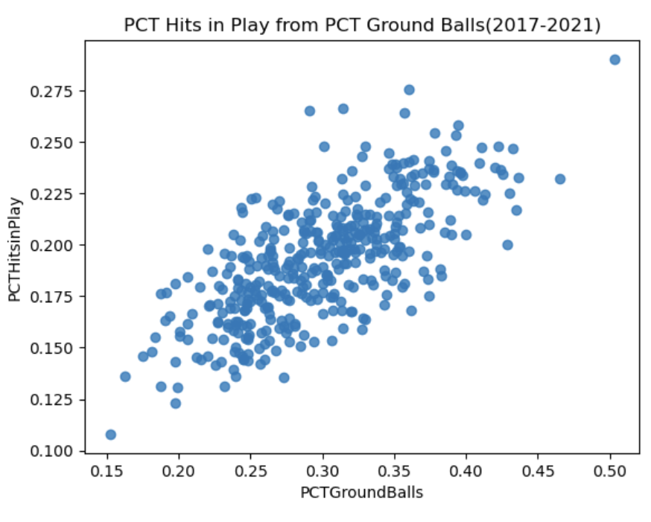
Results
Some relationship between speed and added hustle OPS and speed
Clustering revealed that players with a higher percentage of thes hustle plays are not any faster than other players.
K means clustering after completing dimensionality reduction on PCT ground balls and PCT hits in play. This shows that something other than speed is causing the disparity between players.
Relationship between speed and Added Hustle OPS, which is calculated by multiplying frequency of events by slugging/on base percentage above expected. The orange line is the trendline from the 2017-2021 data.

Slide 8
Conclusions
Speed has a role in predicting Added Hustle OPS
Hustle OPS has a significant role in some players' offensive profile, but for most, not significant.
Players that are involved in "hustle plays" more often are not any faster.

Slide 9
References
Baseball Savant. https://baseballsavant.mlb.com/statcast_search
Baumer, Ben S.; Piette, James; and Null, Brad. 2012. Parsing the Relationship Between Baserunning and Batting Abilities Within Lineups. Statistical and Data Sciences: Faculty Publications, Smith College, Northampton, MA. https://scholarworks.smith.edu/sds_facpubs/40
Baumer, Ben S; and Terlecky, Peter. 2010. Improved Estimates for the Impact of Baserunning in Baseball. https://www.researchgate.net/publication/265059918_Improved_Estimates_for_the_Impact_of_Baserunning_in_Baseball.
Click, James, et al. 2007. “What if Rickey Henderson had Pete Incaviglia’s Legs.” Baseball between the Numbers: Why Everything You Know about the Game Is Wrong. Basic Books, pp. 112-126.
Lewis, Michael. 2004. Moneyball. New York, NY: WW Norton.

